Slide 1
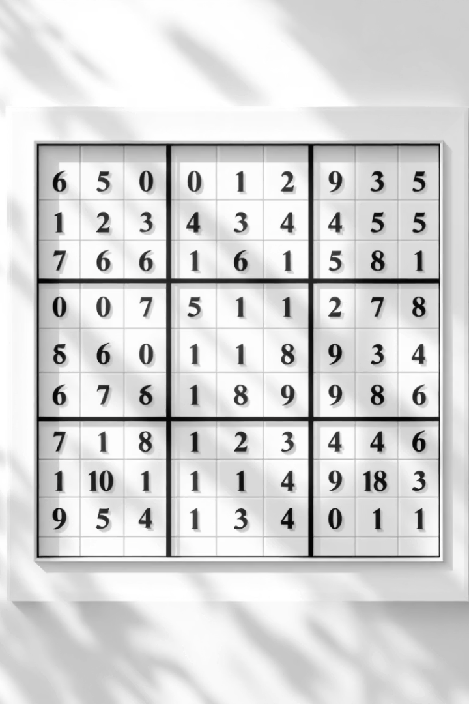
Sudoku Solver: Backtracking, Optimization & File I/O
A terminal-based C++ project leveraging DSA concepts
Presented by: Shaikh Muhammad Irtiza 2023653 Shahram khan 2023648 Komail Lokhandwala 2023460

Slide 2

Project Overview: Problem Statement & Goals
Sudoku Rules
Project Objective
Fill the 9x9 grid so each row, column, and 3x3 box has numbers 1 to 9 without repetition.
Implement an efficient Sudoku solver in C++ that reads puzzles from files and outputs solutions.
Key Features
Supports standard 9x9 puzzles
Backtracking with constraint propagation
File I/O for input/output

Slide 3
Data Structures: Representing the Sudoku Grid
Grid Representation
Alternatives & Tradeoffs
Uses std::vector<std::vector<int>> for dynamic, efficient 2D indexing.
Adjacency lists: complex and unnecessary for Sudoku
Fixed arrays: less flexible, harder with varying input
Integer cells: 0 indicates empty; 1-9 assigned numbers.

Slide 4
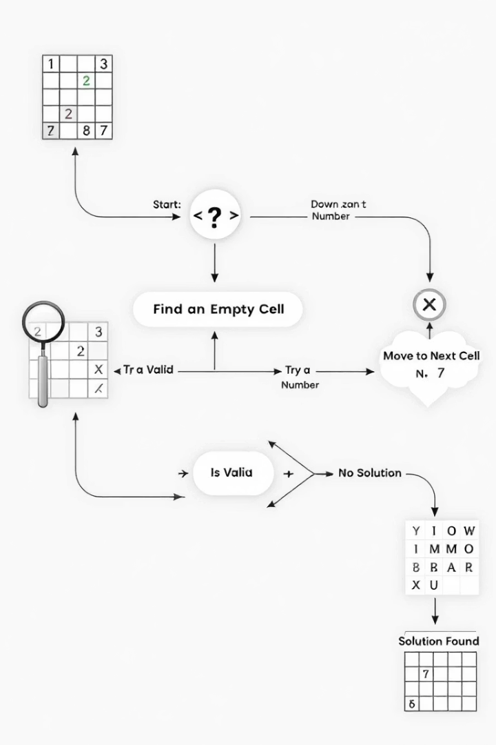




Algorithm: Backtracking Search
Identify Empty Cells
Find next empty position in the grid for filling.
Check Valid Numbers
Ensure candidate number fits row, column, and 3x3 subgrid constraints.
Recursive Search
Place number and recursively solve the next cell; backtrack if invalid.
Base Case
All cells filled correctly, solution found.

Slide 5

Optimization Techniques
Constraint Preprocessing
Smart Cell Ordering
Apply MRV and Degree heuristics to pick most constrained cells first.
Use Naked and Hidden Singles to reduce candidate numbers early.
Performance Analysis
Time complexity varies; pruning significantly cuts worst-case scenarios.

Slide 6
Implementation Details: C++ Code Snippets
isValid()
solveSudoku()
File I/O
Checks if a number can be placed without breaking rules.
Recursively calls itself to find a valid solution.
Reads Sudoku puzzles from text files; outputs results to terminal.

Slide 7
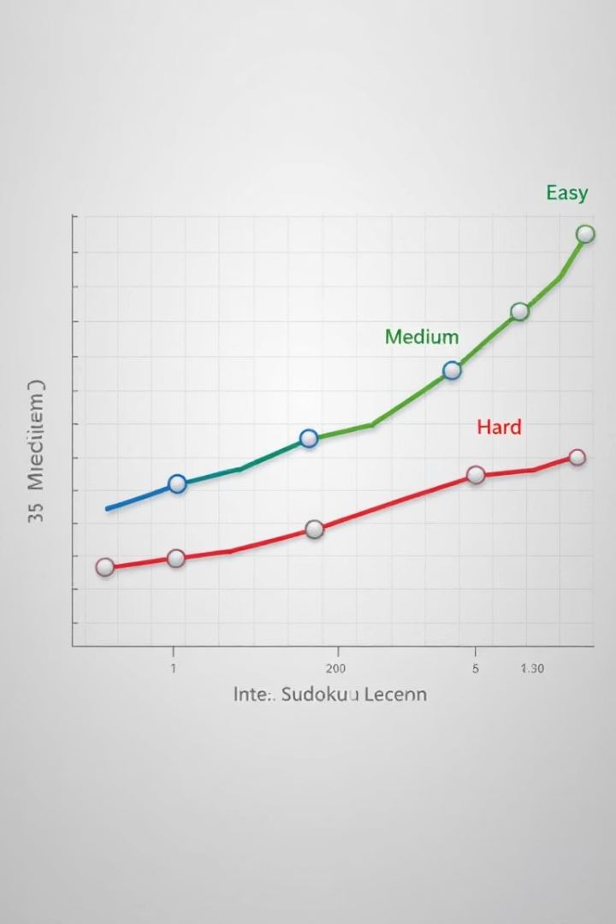
Results & Performance Analysis
Difficulty
Avg. Time (ms)
Backtracks
Easy
10
50
Medium
50
500
Hard
150
1500
Expert
300
3000
Highlights solver efficiency and areas for future enhancement.

Slide 8

Conclusion & Q&A
Project Summary
Takeaways
Integration of backtracking, optimization, and file I/O in C++ solver.
DSA are powerful tools for solving real-world problems efficiently.
Future Work
Add GUI and advanced heuristics for better performance and usability.
Open floor for questions and discussion.

